Slide 1
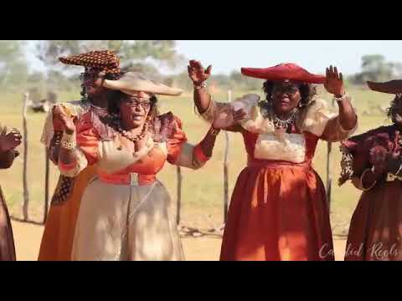
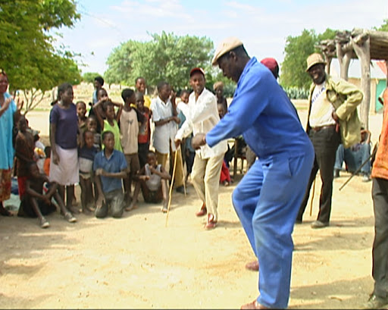
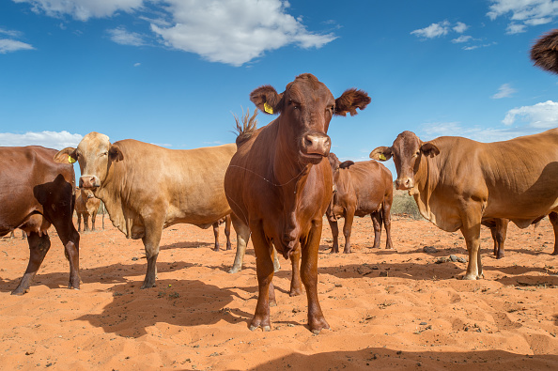
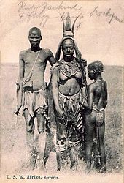
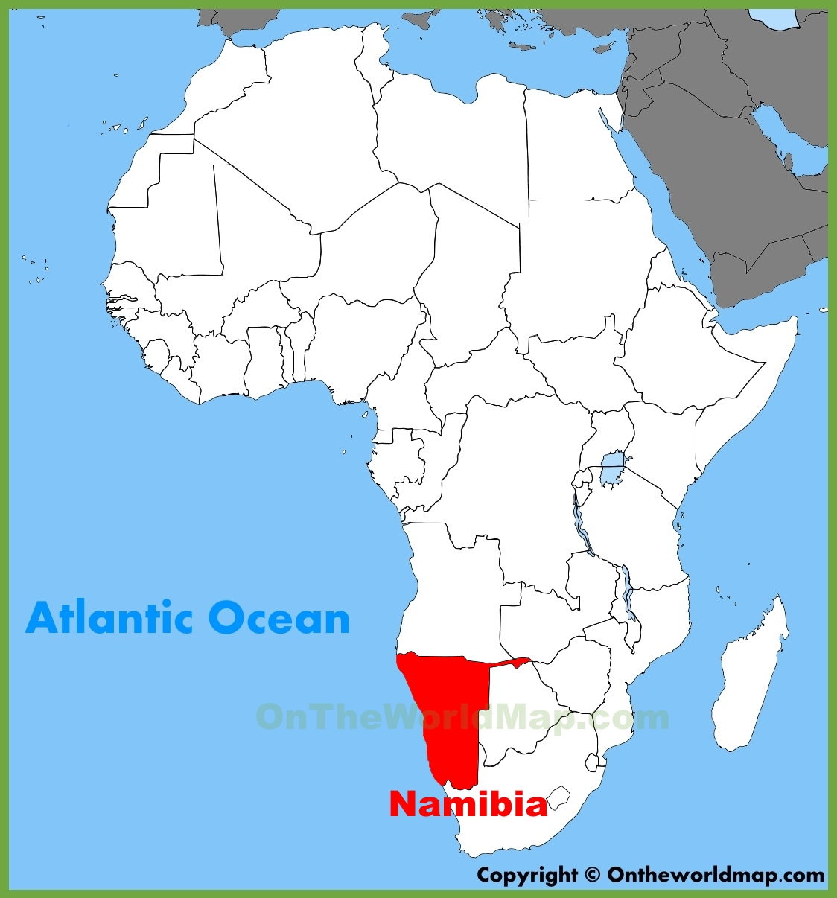
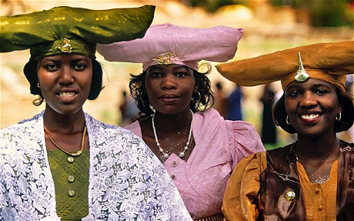
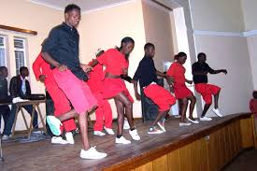
Music of the Herero People
Allie Charney

Slide 2
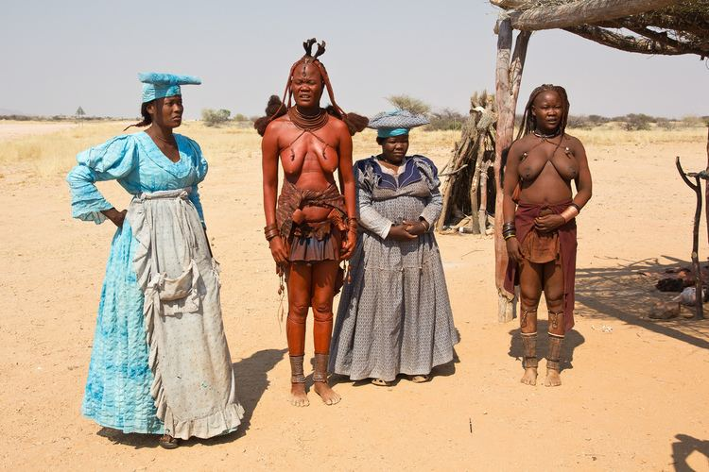
Community
Southern Africa
  Mostly in Namibia
Cattle herders
Monotheistic: Omukuru
Language: Otjiherero (a Bantu language)
Subgroups:
  Tjimbda and Ndamuranda in Kaokoveld
  Maherero around Okahandja
  Zeraua in Omaruru
German colonization – late 19th, early 20th centuries
  Placed in reservations in 1903
  Revolt 1904-1907 resulting in genocide
  Gained independence in 1990
Notes:
traditionally monotheistic and worship the god Omukuru
Practed witchcraft, but now majority converted Christianity
Lots of Christian influence, especially during the time of colonialism.
After subgroups mention that all herero groups share very similar musical styles with slight variations.
Language – obsviously different dialects depending on the region
Then, south Africa took control… wasn’t until 1990 that they gained independence
Mention von Trotha legacy. Descendants of Lothar von Trotha (who was ordered the massacre against Herero people) traveled to Omarur in 2007 to publicly apologize

Slide 3
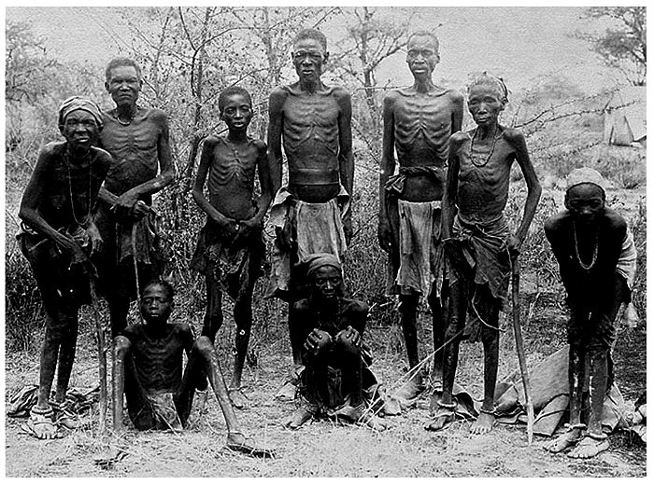
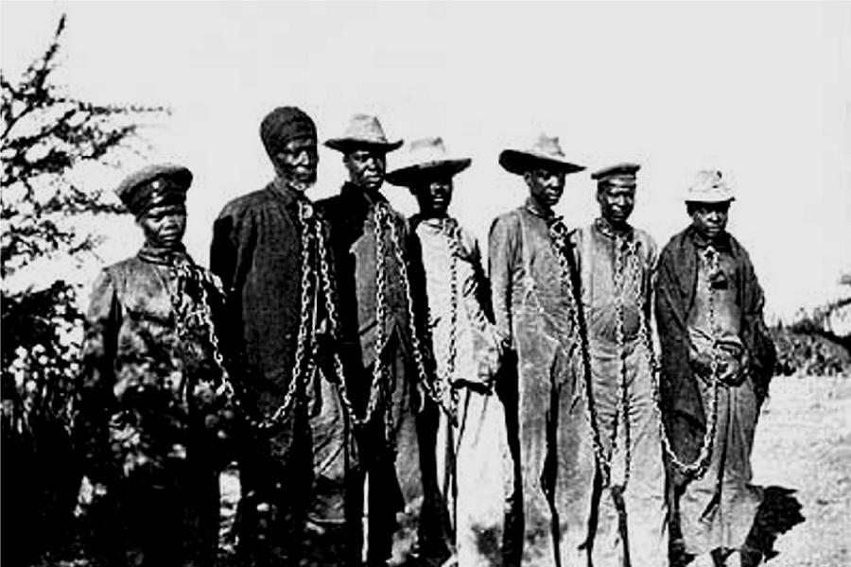
Notes:
Image 2 is herero chained during the rebellion in 1904

Slide 4
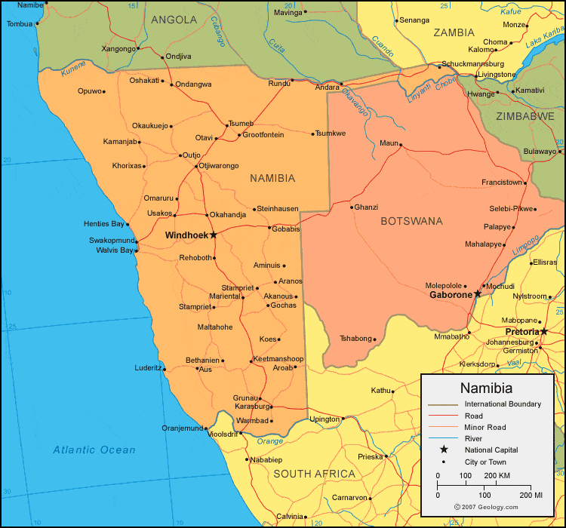
Notes:
Okahandja
Omaruru
Kaokoveld – kunene region

Slide 5
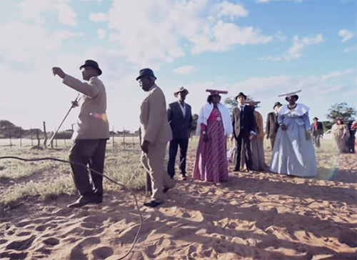
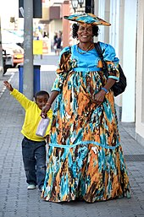
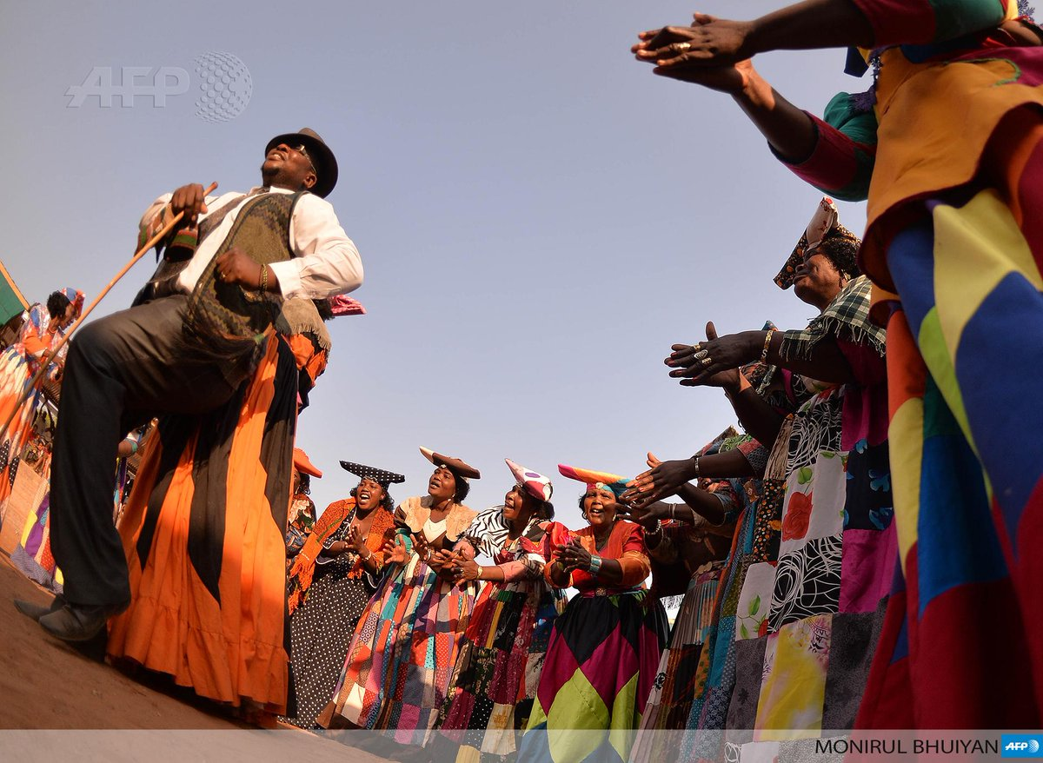
Key Musical Features
Interlocking clapping rhythms
Repetition
Call and response
Improvisatory
Harmonies
“Complex meters” (in Western terms)
  Maximally-even rhythms
Accompanies dances
  Otjongo and Omuhiva
  Stomping and clapping
Storytelling
Rituals or social events
  Weddings, births, deaths, cattle exhibitions…
Dress
Notes:
One of the reasons I chose to focus on Herero music bc it was a challenge finding information that I expected to find, like instruments and super well-known Herero songs. But what I realized is that this music is not formalized at all, it is a social activity where they rely on their voices and bodies, and it is a way of understanding and communicating with each other.
Cyclical
Call and response with a leader / dancer
Otjongo – traditional dance for females and omuhiva for men
Stomping and clapping are huge components to herero music making
Mostly don’t rely on instruments
Very social event
Music and dancing almost synonymous – do usually have one without the other
Dress headpieces resemble cattle horns
Dresses introduced my missionary german wives early 1900s

Slide 6
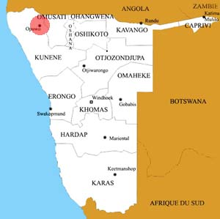
Let’s watch the pros!
https://www.youtube.com/watch?time_continue=791&v=muI0A615dXw&feature=emb_title
  Recorded in Oruvandjei
Notes:
Which is right by opawa

Slide 7

Ensembles
Oviritje genre
Sung in Otjiherero
Vocals → keyboard
Bands
Introduce to a modern band class!
“Ehinga” by Wild Dogs
  https://www.youtube.com/watch?v=o1RjJVdLi1A
Notes:
Language of herero people
Originally performed with only vocals until Kareke Henguva made it popular with the introduction of the keyboard to the music
Now there is Modern Oviritje genre
could teach lesson to a modern band class which is common in secondary schools

Slide 8
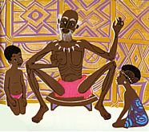
Transmission Processes
By ear
Storytelling by oral tradition
Dances help remember music
Rhythms heard from birth
In classroom setting
  Teach by ear first
  Notation if needed
Notes:
Teach by ear first – especially ostinati and difficult rhythms that are confusing in western notation!
Grow up with this music – not part of a formalized education taught in schools
Associate movement with their music
Classroom – teach by ear, expose students to original footage, acknowledge my lack of mastery and that I am learning also!

Slide 9
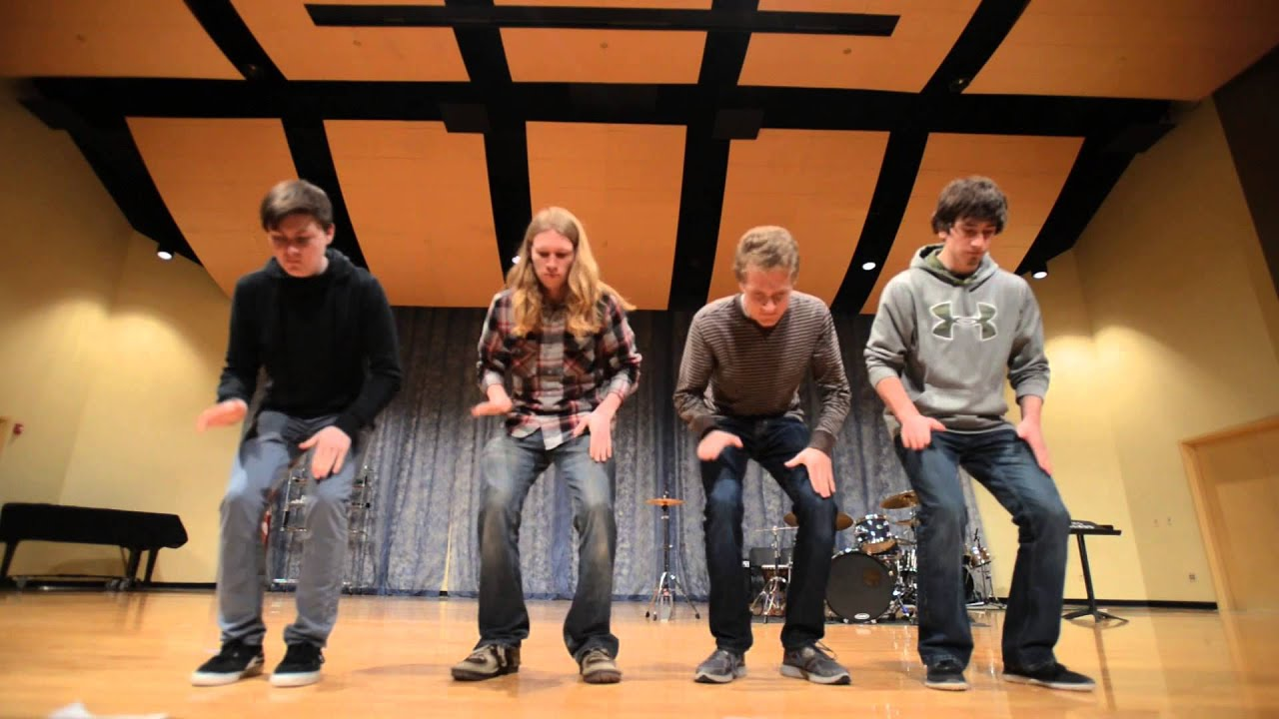
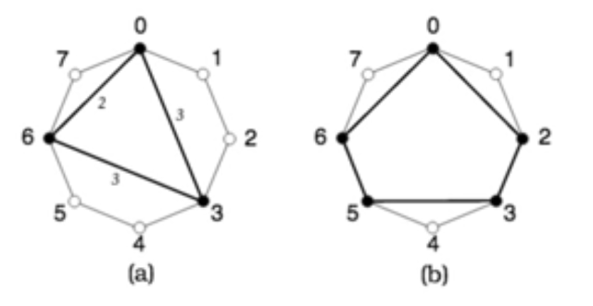
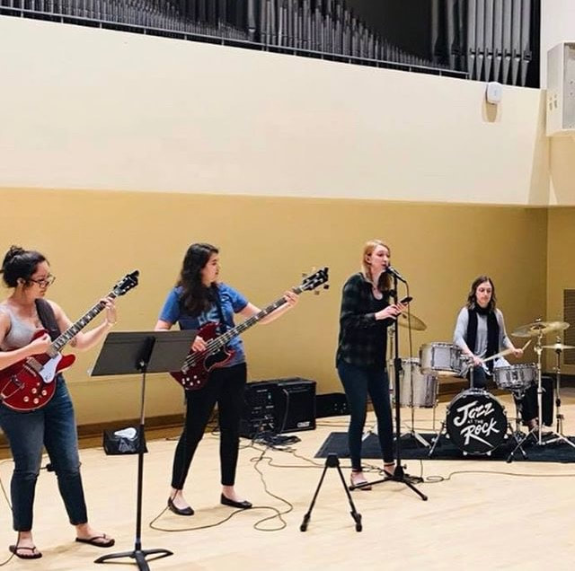
Curriculum Plan
Complex meter
Euclidean rhythms
Partner project – interlocking rhythms
Storytelling
  Morals, folklore, politics, values
Add body percussion
  Stomps and claps
Call and response
Practice improvisation with harmonies and rhythm
Modern band – Oviritje music

Slide 10
Questions to Consider
~ inspired by Schippers and Sweet ~
How will you handle the different biases surrounding “African music”?
How will you challenge canonized knowledge?
How will you encourage the students to expand their canon of music?
How will you approach authentic music making, while also acknowledging the recontextualization of the musicking?
Notes:
Canonized Knowledge = knowledge learned in textbooks and through the school system’s perspective which is thought to be objective but really is NOT

Slide 11
Sources
Dobbins, J., Jones, S., Crane, K., Rathmell, A., Steele, B., Teltschik, R., & Timilsina, A. (2005). “Namibia.” In The UN's Role in Nation-Building: From the Congo to Iraq (pp. 29-44). RAND Corporation. Retrieved February 18, 2020, from www.jstor.org/stable/10.7249/mg304rc.11
Ejikeme, A. (2011). Culture and customs of Namibia. Santa Barbara: Greenwood.
Gewald, J. (2007). “Coming Through Slaughter: The Herero of Namibia, 1904–1940.” In Rao A., Bollig M., & Böck M. (Eds.), The Practice of War: Production, Reproduction and Communication of Armed Violence (pp. 89-110). Berghahn Books. Retrieved February 18, 2020, from www.jstor.org/stable/j.ctt9qcjpc.10
Harpending, H., & Pennington, R. (1990). “Herero Households.” In Human Ecology (pp. 417- 439). Retrieved February 18, 2020, from www.jstor.org/stable/4602990.
Horn, D., Shepherd, J., Kielich, G., & Feldman, H. C. (2019). Bloomsbury encyclopedia of popular music of the world: Volume 12.
Kössler, R. (2015). “Namibia’s Germany: Transnational Implications of Settler Colonialism.” In Namibia and Germany: Negotiating the Past (pp. 99-116). Namibia: University of Namibia Press. Retrieved February 18, 2020, from www.jstor.org/stable/j.ctvh8r4d4.10
The Editors of Encyclopaedia Britannica. (2010). “Herero.” Retrieved from https://www.britannica.com/topic/Herero
van Wolputte, S., & Bleckmann, L.E. (2012). The ironies of pop: Local music production and citizenship in a small Namibian town. Africa: The Journal of the International African Institute 82, 413-436. https://www.muse.jhu.edu/article/483236.

